Slide 1
BPAC w/Bike Clark County
Movie at Evergreen Park photos (9/10/2016)

Slide 3
Light system

Slide 4
Light installation

Slide 5
Pinky promise to wear helmet while skateboarding.

Slide 9
Helmet fitting

Slide 10
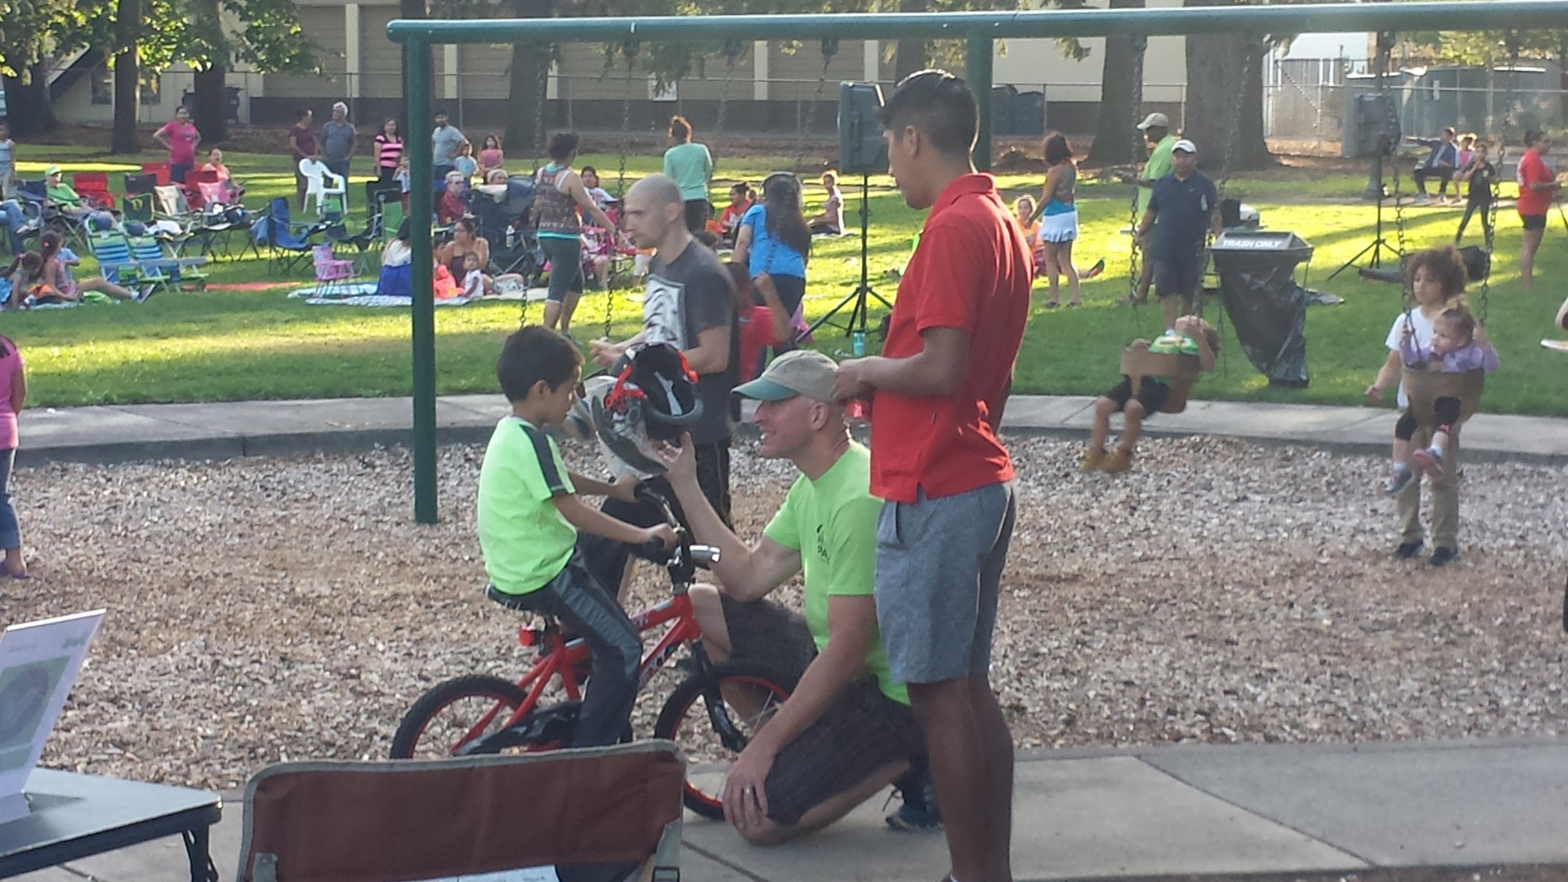

Slide 15
Happy customer!

