Slide 1
CLARK COUNTY CORRECTION FACILITY ADVISORY COMMISSION
April 24, 2018

Slide 2
Welcoming/Opening Remarks Clark County Chair, Marc Boldt

Slide 4
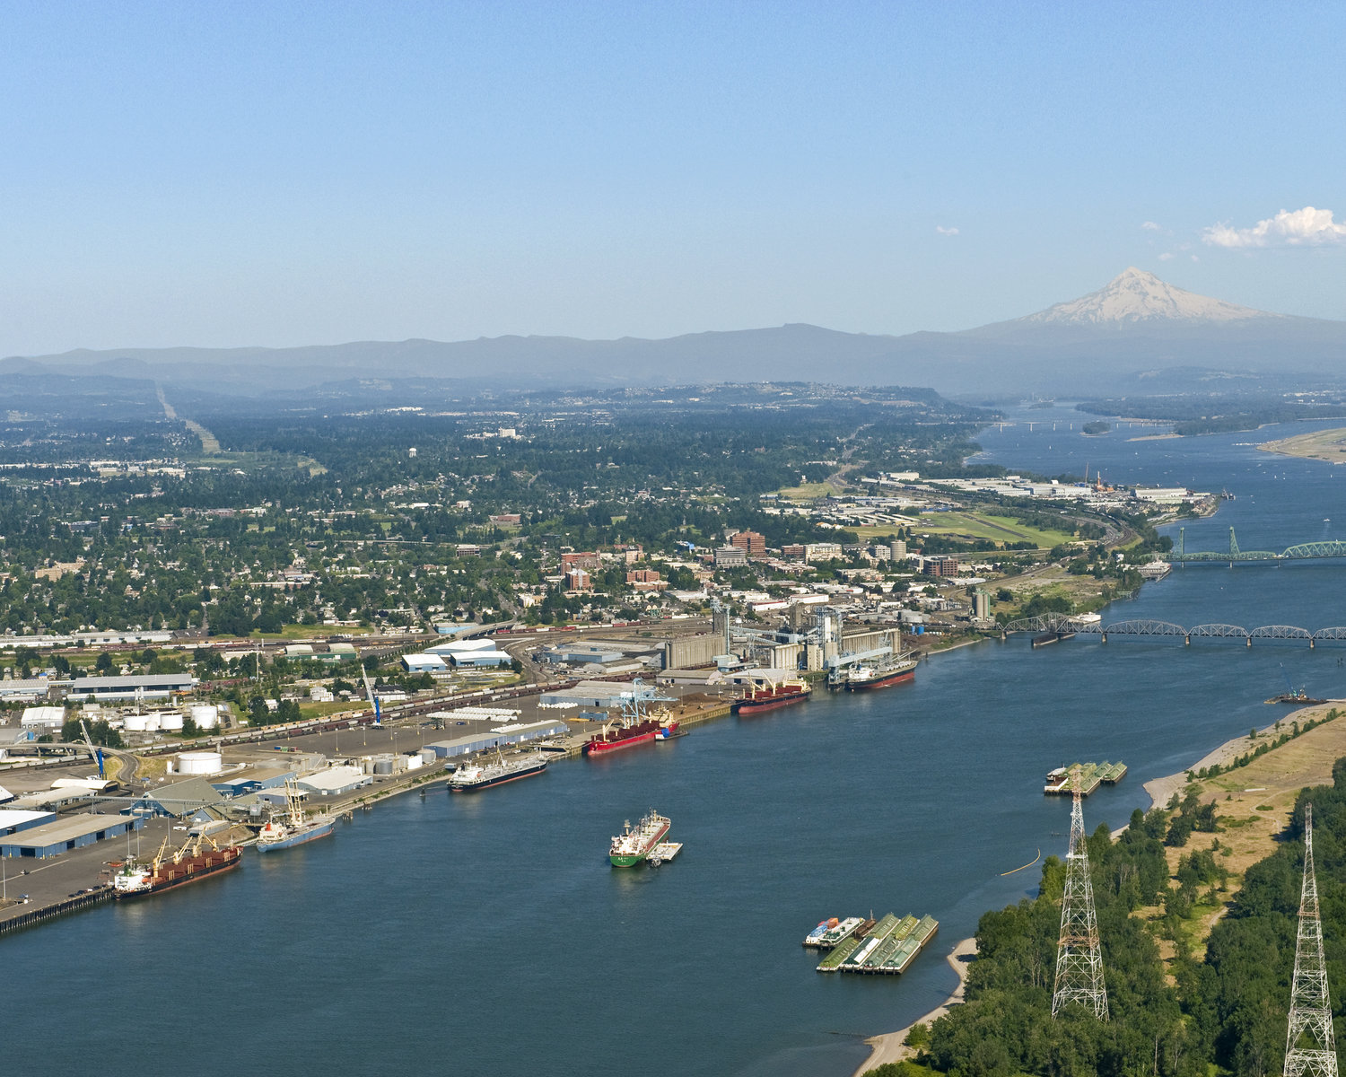
AGENDA
Opening Remarks
Agenda Review & Meeting Objectives
Commission Member Introductions & Expectations
Commission Process & Timeline Review
BREAK
Orientation: Clark County Jail Overview & Challenges
Commission Interviews & Survey Summary
Commission Discussion: Top Priorities for Future Jail
Closing Remarks

Slide 5
COMMISSION MEMBER INTRODUCTIONS & EXPECTATIONS

Slide 6
Introductions & Expectations
Name / Organization
Role with Jail
Have you (voluntarily) toured a jail?
What are your expectations for this Commission?

Slide 7
COMMISSION PROCESS & TIMELINE REVIEW

Slide 8
Work Plan Highlights
Orientation – Presentations and Jail Tours
Objectives / Considerations
Facility Space Needs
Program Needs
Renovate / Build
Cost Estimates and Finance Options
Public Survey
Recommendations & Report

Slide 9
Meeting Protocols
Be present
Participate
Be open and positive
Represent your organizational interest
Respect each other
Look for solutions
Have fun

Slide 10
Bylaws: Highlights
Membership Composition
Steering Committee Role – administrative, appointments, scope
Commission – make recommendation based on assessment
Officers – Chair / Vice-Chair
Meetings – 2nd and 4th Tuesdays

Slide 11
CLARK COUNTY MAIN JAIL OVERVIEW & CHALLENGES Chief Corrections Deputy Ric Bishop

Slide 12
COMMISSION INTERVIEWS & SURVEY SUMMARY

Slide 13
SUMMARY POINTS
CURRENT UNDERSTANDING
Most familiar with main jail based on role. Some have little knowledge about it.
Majority - strong understanding of jail’s community role.
DLR study: Majority reviewed. Many cited concern focus was too narrow – “facility focused.” it although many raised concerns that its focus was too narrow.

Slide 14
SUMMARY POINTS
MAIN JAIL FACILITY – CURRENT PERSPECTIVES
Main jail facility is overcrowded and no longer an effective corrections facility.
Much praise for Sheriff’s corrections staff professionalism.
There is a safety risk to staff and inmates – and the liability.
Increased capacity is needed, but some note it may have been possible to divert some of the population.
Specific areas of the jail cited as inadequate: booking area, medical unit, and interview rooms.
Inadequate programming for mental health and substance abuse in the jail, as well as for diversion.

Slide 15
SUMMARY POINTS
FUTURE CORRECTION FACILITY NEEDS AND PLANNING
Top priorities for new or renovated jail: (1) space
(2) staff and inmate safety
(3) cost (including operational)
(4) services /programs
Importance of public support
Location: evaluate all options not just current site

Slide 16
SUMMARY POINTS
COMMISSION PROCESS
Many participants not clear on the parameters of Commission’s charge.
Perception that County may have already decided to build/renovate on current site.
Most frequent information request: status of the existing jail and current trends that will impact its operation.

Slide 17
TOP PRIORITIES FOR FUTURE JAIL

Slide 18
Discussion
Divide into small groups
Pick a spokesperson & scribe
Discuss and agree on three top priorities for a future jail (you have 20 min)
Report out

Slide 19
CLOSING REMARKS

Slide 20
CLARK COUNTY CORRECTION FACILITY ADVISORY COMMISSION
COMMISSION MEETING
APRIL 24, 2018

