Slide 1
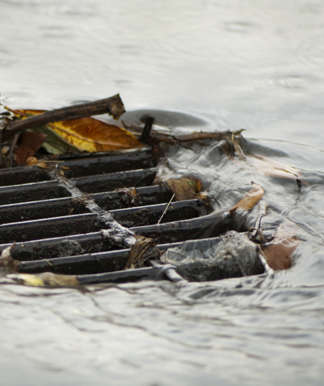
Clark County
Clean Water Division
An overview of the Education / Outreach program
Public works
1300 Franklin St.
Public Service Center
Vancouver, WA 98666-9810
(360) 397-2121
cleanwater@clark.wa.gov
www.clark.wa.gov/stormwater

Slide 2
Who/What are we required to educate?
Educational Goal
Audiences
NPDES Phase I Municipal Stormwater Permit
2013-2018
General impacts of stormwater
Impacts of impervious surfaces
Illicit discharge & how to report
LID principles & BMPs
Opportunities for stewardship
Technical standards for SW sites
Students
General public
Businesses
S5.C.10.a-c
Engineers/
Contractors
Stormwater treatment
Flow control BMPs
Use & storage of materials (HHW)
Equipment & vehicle maintenance
Carpet cleaning
Pet waste
Dumpster / trash / compactors
Property
Managers
Developers
Land Use Planners
Build awareness of stormwater problems
Effect behavior
Create and/or partner with others to provide stewardship opportunities
Measure understanding of targeted behaviors (completed 2015 – Gas Station Spill Kit program)
Use measures to target outreach efforts
On-going
✓
Notes:
36 specific points to cover, as well as internal outreach / education for staff

Slide 3
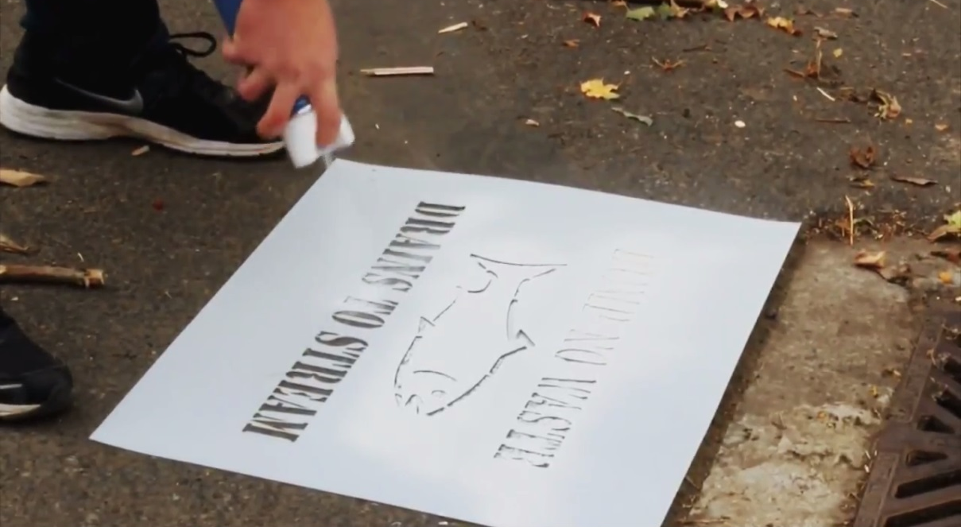
Education & Outreach programs:
Examples of educational messages:
Canines for Clean Water – pick up pet waste
Business Source Control – don’t dump or wash materials down storm drains, repair dumpsters
Green Neighbors – information that applies to residential homes (lawns, health landscapes, water conservation, etc.)
Schools – student watershed monitoring network partnership with the City of Vancouver & Green Schools
Small Acreage Program – large lot properties can manage manure and other runoff risks partner with WSU-Extension
Spill Kit Program – provide information on how to clean up small spills at businesses to prevent pollution
Web-based information
Printed materials
Event-based learning
Hands-on learning – Stewardship
Technical Assistance visits
www.clark.wa.gov/public-works/what-you-can-do-clean-water
Notes:
Visit our web page for “What you can do for Clean Water” to learn more about the various ways to protect water. The web page also includes links to other community partners who help educate on stormwater.
Web based information, data and links
Printed materials – fact sheets, fliers, brochures, bookmarks
Event based learning – Set up a booth at an event such as EcoFair Earth Day, teacher training, workshops
Hands-on learning – Stewardship opportunities such as student water quality monitoring, drain marking
Technical Assistance visits – Green Business and Source control staff meet with business, Specialists work with HOA’s & property managers

Slide 4
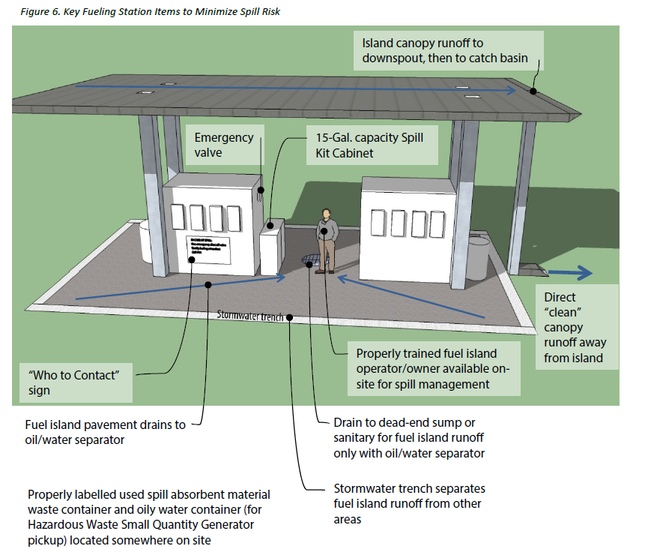
Measure Understanding
Fueling Stations &
Spill Kit Use
(Spill management techniques)
54 Fueling stations
 About a dozen new / good design
 About a dozen high priority, pose a risk to the MS4
 Technical visits key to successful education

Slide 5
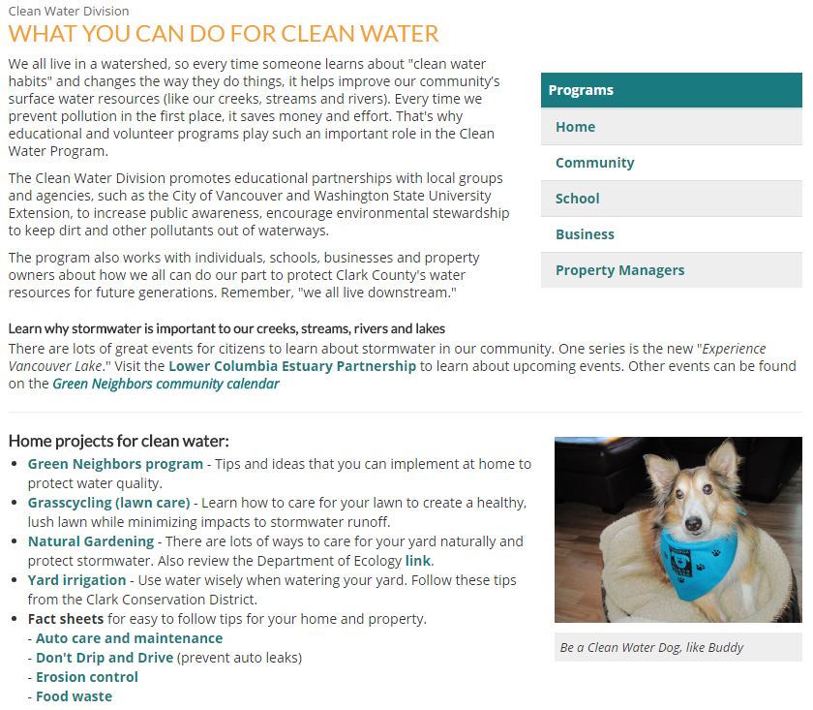
Do you need more information?
Contact the
Clean Water Division:
1300 Franklin St.
Vancouver, WA 98666-9810
(360) 397-2121
www.clark.wa.gov/
stormwater/
what-you-can-do-clean-water
Heath Henderson
Director, Public Works Department
Dean Boening
Division Manager, Clean Water
Protecting our waterways for generations to come

