Slide 1
Clark County Sheriff’s Office
Paws On Patrol

Slide 2
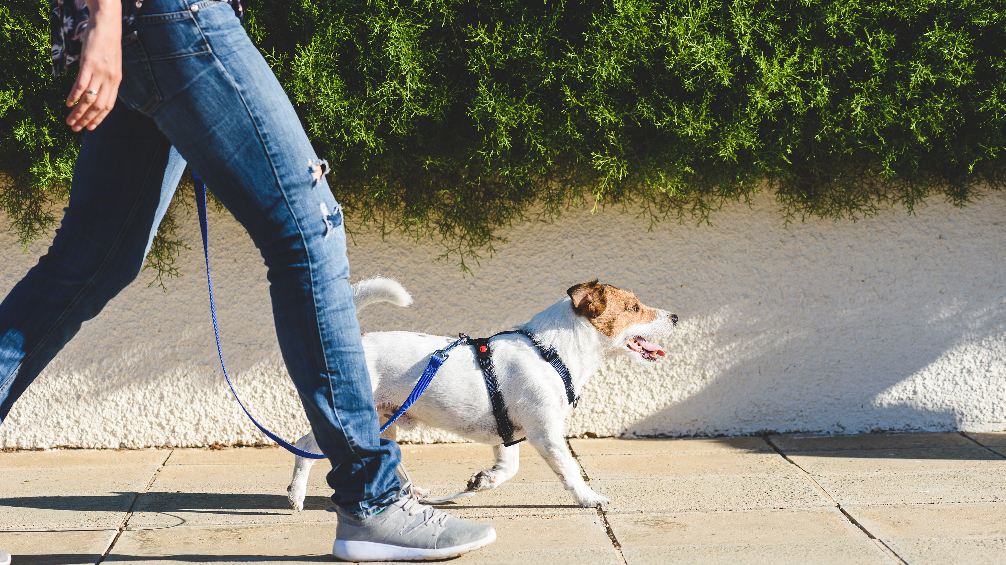
About Paws on Patrol
There are dozens, if not hundreds, of dog walkers throughout Clark County at all times of the day. These walkers are often preoccupied talking on their phones, texting, or listening to music during their neighborhood walks. This is hundreds of potential pairs of extra eyes and ears watching for suspicious activity and alerting law enforcement when something appears out of place.
Paws on Patrol is a crime awareness program that encourages dog (or cat) walkers throughout the area to assist as “extra eyes and ears” in the ongoing fight against crime The program was inspired by Dog Walker Watch, a nationwide program sponsored by the National Association of Town Watch.
The Paws on Patrol program trains you how to effectively observe and report suspicious activity as you are routinely out in your neighborhood.

Slide 3
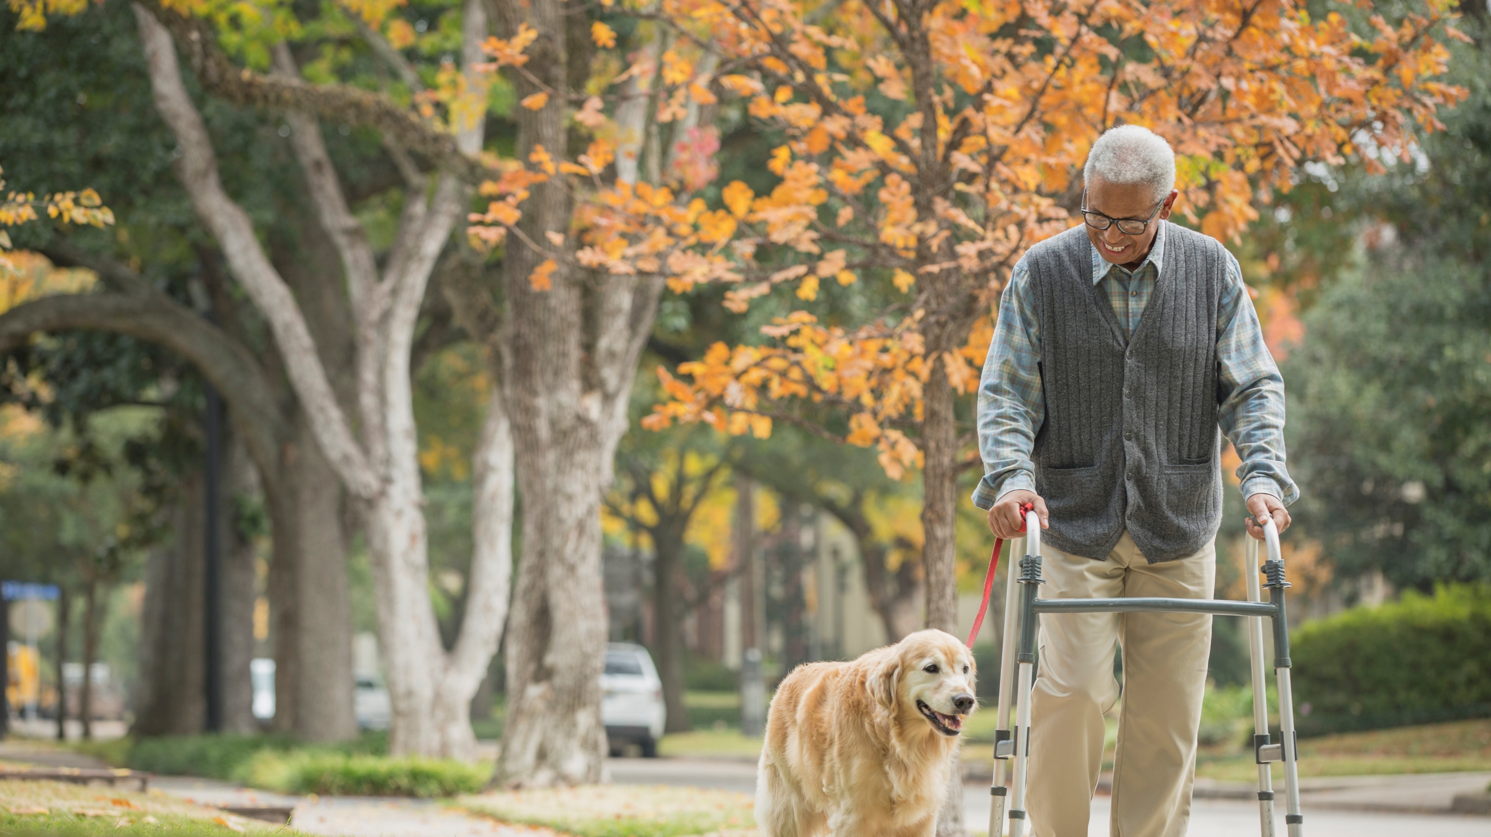
The goal of the program is for residents to take an active role in their community to increase the safety in our neighborhoods by doing what they already do. No one is more familiar with their neighborhood than those who routinely walk it.

Slide 4
Paws on Patrol trains you how to recognize and report criminal activity as you are routinely out in your neighborhood or park.
Those who know the neighborhood best (you) now become more aware and less hesitant to report suspicious activity.
Paws on Patrol is not just for dog walkers. Maybe you walk with your cat? Or without a pet at all. Anyone who regularly walks their neighborhood or park can participate!

Slide 5
Be a good neighbor.
Neighbors watching out for neighbors is one of the best tools we can employ in the fight against crime. Law enforcement cannot do it alone.
Look around for unusual things. Walkers who routinely walk their neighborhood are familiar with what is normal activity and what looks out of place.
Consider what neighborhood incidents should involve police versus when you can turn to other public safety resources.

Slide 6
Keep your head up, scan and pay attention to your surroundings.
Distractions
Phones, headphones and AirPods can make it more difficult to be aware of your surroundings. When out on your walk, limiting your use of these devices will make you a better observer, and being more aware of your surroundings is safer for you, too!

Slide 7
Examples of Suspicious Activity
Persons going door-to-door in your neighborhood with no identification
Noises such as gun shots, screaming, sounds of fighting, breaking glass
Vandalism, property damage, graffiti in progress
A car following a delivery van or someone taking packages from porch.
Loitering around or peering into cars and trying door handles
A person removing car parts, license plates, or gas
Heavy foot traffic to and from a certain residence that occurs on a regular basis during unusual hours
Unfamiliar vehicle parked on your street that you suspect may have been stolen
Remember: People aren’t suspicious, behavior is!

Slide 8
Things to keep in mind:
Not every stranger is a criminal, and some circumstances have a perfectly logical explanation
Factors such as race, ethnicity, and/or religious affiliation alone are not suspicious
DO NOT ATTEMPT TO APPREHEND A PERSON COMMITTING A CRIME OR INVESTIGATE A SUSPICIOUS ACTIVITY.

Slide 9
Be a Good Witness

Slide 10
There are several options to report suspicious or criminal activity.
9-1-1 for emergencies
3-1-1 for non-emergency law enforcement assistance
Online reporting
Tip lines
Call your local law enforcement agency directly

Slide 11
When should I call 9-1-1
Any time a police response is needed for something IN PROGRESS.
when life or property is threatened or at immediate risk, or if there is a good chance that a criminal can be apprehended.
What to do when you call 911…..
Tell us the nature of the emergency.
What is going on? Description of subject. Weapons? Time of incident?
Where are you? Address, street name, landmark, location, etc.
Your information: Your name and your phone number.
Are you available to speak with an officer?
Let the operator ask the questions.
Please remain calm and speak clearly.
Inadvertently call 911? Don’t hang up.
https://cresa911.org/DocumentCenter/View/139/When-Calling-9-1-1-PDF?bidId=

Slide 12
Calls that are not an emergency can be made to 3-1-1 or 360-693-3111
A few guidelines to follow when you decide if you want to call 9-1-1 versus 3-1-1:
Always use 9-1-1 for any fire and medical call, no matter how minor you think the medical complaint is.
Call 9-1-1 if your police complaints involves a gun, is a crime happening now, or a situation that needs police to prevent or stop an injury or property damage.
3-1-1 is the alternate number to report non-emergency law-enforcement-related complaints.
These include:
Abandoned vehicles/suspected stolen vehicle/ car prowls
Package and mail thefts
Noise complaints
Found property that could be evidence (like a discarded weapon).

Slide 13
Online reporting:
Most non-violent crimes can be reported online. Examples: Illegal dumping, lost/found property, and vandalism
https://cresa911.org/159/Online-Reporting
If the crime occurred in unincorporated Clark County, Yacolt and Amboy;
https://clark.wa.gov/sheriff/file-crime-report
In the city of Battle Ground;
https://report.citizenserviceportal.com/home/Agency?AgencyCode=BGPD

Slide 14
Tip Lines:
You may also leave information or report suspected criminal activity at one of our two Tip Lines. You can remain anonymous.
Sheriff's Office Tip Line - 564.397.2847
Drug Task Force Tip Line - 564.397.6017

Slide 15
Other Community Resources:
It’s Your neighborhood!
Neighborhood Guide
https://clark.wa.gov/sites/default/files/media/document/2021-12/ce-community-guide-spreads_0.pdf
Clark County Neighborhood Outreach Program
https://clark.wa.gov/county-manager/about-neighborhood-associations
Clark Regional Public Alerts is a free service that allows you to sign-up online to receive customized alerts in various emergency situations and information about road closures, safety, health, utility disruptions and more…
To sign up for Clark Regional Public Alert System
https://member.everbridge.net/453003085616336/login

Slide 16
Thank you for completing the training! Be sure to watch the video (link is on registration page).
Your free Paws on Patrol pet tag will be mailed to the address on your registration form within two weeks.

Slide 17
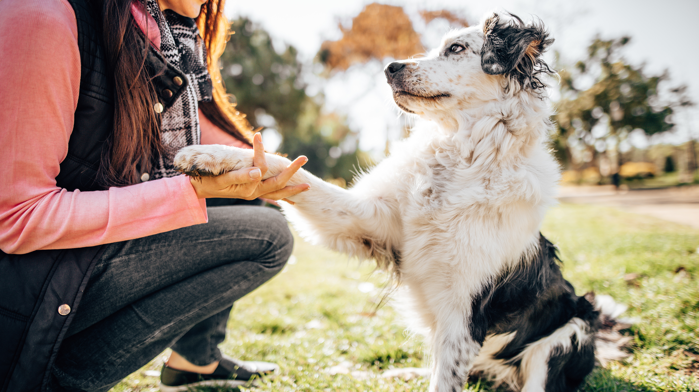
Stay tuned…
As a Paws on Patrol participant, you may receive emails with crime prevention and personal safety tips from patrol deputies.
Future plans for Paws on Patrol include;
an annual gathering in the park where Paws on Patrol participants can meet each other and their local law enforcement officers.
AND a Pet Spotlight!

Slide 18
Thank you for participating in the Paws on Patrol Program!
We look forward to partnering with you in protecting and safeguarding our community!
-Sheriff John Horch

Slide 19
Questions?
Contact the Clark County Sheriff’s Office Community Outreach Unit
Phone: 564-397-3380
Email: CntySheriff.CommunityOutreach@clark.wa.gov

